Slide 1

Customer Shopping Behavior Analysis
Analyzing 3,900 transactional records to uncover key insights into spending patterns, customer segments, product preferences, and subscription behavior.

Slide 2

Project Scope and Dataset Summary
Project Goal
Key Features Analyzed
Guide strategic business decisions by analyzing customer shopping behavior across various product categories.
Demographics
Purchase Details
Age, Gender, Location, Subscription Status.
Item, Category, Amount, Season, Size, Color.
Dataset includes 3,900 rows and 18 columns of transactional data.
Behavior
Discount, Promo Code, Previous Purchases, Review Rating.

Slide 3

Exploratory Data Analysis (EDA) in Python
Initial data preparation, cleaning, and feature engineering were performed in Python before loading the data into PostgreSQL for structured analysis.
01
02
Data Cleaning
Standardization
Imputed 37 missing values in the Review Rating column using the median rating per product category.
Renamed columns to snake case for better readability and documentation.
03
04
Feature Engineering
Integration
Created age_group (binned ages) and purchase_frequency_days columns.
Connected Python script to PostgreSQL and loaded the cleaned DataFrame for SQL analysis.

Slide 4
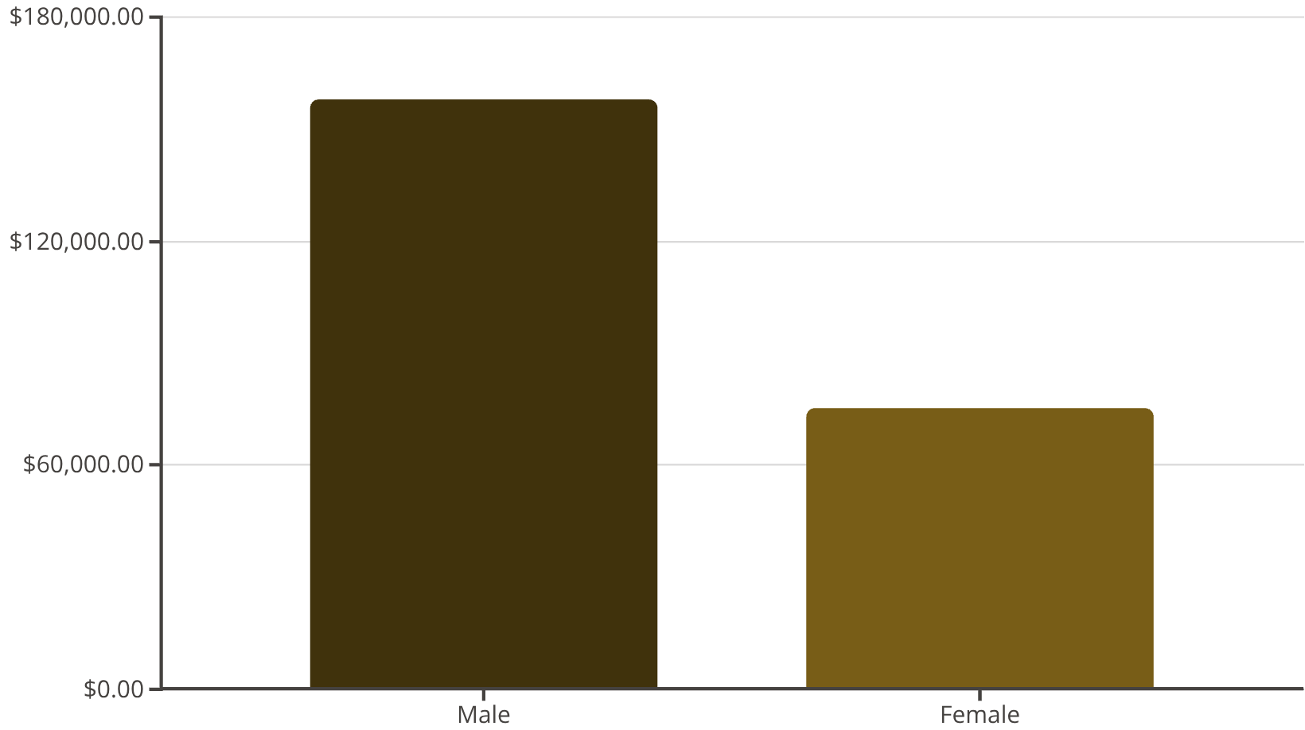
Revenue Comparison by Gender
Analysis of total revenue generated by male versus female customers shows a significant difference in spending.
$157.9K
$75.2K
Male Revenue
Female Revenue
Total revenue generated by male customers.
Total revenue generated by female customers.

Slide 5



Customer Segmentation and Loyalty
Customers were segmented based on purchase history, revealing a high proportion of loyal buyers.
New
1
83 Customers
Returning
2
701 Customers
Loyal
3
3,116 Customers
Repeat buyers (customers with >5 purchases) are significantly more likely to subscribe: 958 subscribers vs. 2,518 non-subscribers.

Slide 6
Product Performance and Preferences
Identifying top-rated products and those most frequently purchased with a discount.
Top 5 Products by Rating
Top 5 Discount-Dependent Products
Gloves: 3.86 Avg. Rating
Products with the highest percentage of discounted purchases:
Sandals: 3.84 Avg. Rating
Boots: 3.82 Avg. Rating
50%
Hat: 3.80 Avg. Rating
Hat
Skirt: 3.78 Avg. Rating
49.66%
Sneakers
49.07%
Coat
48.17%
Sweater
47.37%
Pants

Slide 7


Subscription and Shipping Insights
Comparing average spend and revenue between subscribers and non-subscribers, and across shipping types.
Express Shipping Users
Non-Subscribers
Average purchase amount is higher for Express Shipping ($60.48) compared to Standard ($58.46).
Generate higher total revenue ($170.4K) and slightly higher average spend ($59.87) than Subscribers ($62.6K revenue, $59.49 spend).
High-Spending Discount Users
839 customers used discounts but still spent above the average purchase amount.

Slide 8
Top Products Across Categories
Identifying the three most purchased items within the Accessories, Clothing, Footwear, and Outerwear categories.
Accessories
Clothing
Jewelry (171 orders)
Blouse (171 orders)
Sunglasses (161 orders)
Pants (171 orders)
Belt (161 orders)
Shirt (169 orders)
Footwear
Outerwear
Sandals (160 orders)
Jacket (163 orders)
Shoes (150 orders)
Coat (161 orders)
Sneakers (145 orders)

Slide 9

Revenue Contribution by Age Group
Analyzing which age segments contribute the most to total revenue.
Young Adult
Middle-aged
Adult
Senior
$62,143 — highest contribution
$59,197 — close second
$55,978 — moderate share
$55,763 — slightly lower
The Young Adult group generates the highest revenue, followed closely by the Middle-aged segment.

Slide 10
Strategic Business Recommendations
Key actions derived from the data analysis to drive growth and improve profitability.
Boost Subscriptions
Promote exclusive benefits to increase subscriber base, especially targeting repeat buyers.
Customer Loyalty Programs
Implement rewards to move returning customers into the highly valuable "Loyal" segment.
Targeted Marketing
Focus campaigns on high-revenue age groups (Young Adult, Middle-aged) and Express Shipping users.
Product Positioning
Highlight top-rated products (Gloves, Sandals) and best-sellers in marketing campaigns.
Review Discount Policy
Carefully review the discount strategy to balance sales boosts with margin control, given the high discount dependency of some products.

